Slide 1
MEDITATION
People are not what they say but what they do; so judge them not from their words but from their actions!!!!!

Slide 2
INTERROGATIVE SENTENCES

Slide 3
YES/NO QUESTIONS
Yes/no questions are questions whose expected answers are YES or NO. They are called closed questions because there are only two possible responses: yes or no.
These questions must include one of these verbs forms:
Be ( Am, is, are)
Do ( do, does, did)
Have ( have , has, had)
Modal verbs ( can, must, may )
Will, shall, should, would

Slide 4
STRUCTURE
Auxiliary/modal+ Subject + ( verb)+ object/ complement?
1) Is the patient in the waiting room?
Yes, the patient is in the waiting room.
No, the patient is not in the waiting room.
2) Will doctors get a meeting tomorrow?
Yes, doctors will get a meeting tomorrow
No, doctors will not get a meeting tomorrow
3) Did all the pupils attend school last year?
Yes, all the pupils attended school last year.
No, all the pupils did not attend school last year

Slide 5
SHORT ANSWERS TO YES/NO QUESTIONS
Affirmative: Yes, subject pronoun + auxiliary/modal
Negative: No, subject pronoun + Negative contracted auxiliary/modal
1) Is the patient in the waiting room?
Yes, he is.
No, he isn’t.
2) Will doctors get a meeting tomorrow?
Yes, they will
No, they won’t
3) Did all the pupils attend school last year?
Yes, they did.
No, they didn’t

Slide 6
Activity: Ask Yes/no questions from these sentences
Yes, I am happy.
No, Awa does not go to school.
Yes, I like mangoes.
No, muslims don ’t eat pork.
Yes, her sister has two children.
Yes, this small girl runs fast.
No, Emy is not good at Mathematics.
Yes, I will travel to Bobo .
Yes, this girl can ride a horse.
Yes, every child must go to school.
No the pen is not in this bag.
Yes, these animals are very dangerous.

Slide 7
WH- questions
Wh – questions are questions that cannot be answered by yes or no. They start with words like:
What :asking for information about something/asking for repetition or confirmation
What are your hobbies? / What are they doing right now?
What? I can’t hear you
When :asking about the moment, the period
When will you be back? I will be back in one week,
For time, we say « At what time…? »
At what time do you wake up?
I wake up at 5.

Slide 8
Where :asking in or at what place or position.
Where do they live?
Where are you taking your classes?
- Which :asking about choice
Which colour do you want?
Which country are you dreaming of?
- Why asking for reason, asking what… for
Why do you say that?
Why did they stop going to school?
Whose: asking about ownership
Whose keys are these?
- Whom: asking what or which person or people ( Object)
Whom did you see in room 16?
Who: asking what or which person or people ( subject)
Who opened the door?

Slide 9
How asking about manner, means, state
How do you go to school? / How does this work?/ How are you doing?
*How far : about distance
How far is Ouahigouya from Ouagadougou?
*How long: asking about lenght ( time or space)
How long will it take ?
*How many: asking about quantity ( countable)
How many students are registered for Master I?
*How much: asking about quantity, the price ( uncountable)
How much sugar is necessary for this cake?
How much is bachelor school fees?
*How old: asking about age?
How old is your grand mum?

Slide 10
Activity 1: Ask wh- questions from the underlined words in the sentences
This patient is 15 years old.
The patients are waiting in Room 15.
Ouaga-Ouahigouya is 185 km.
Mr. Ky goes to his office on foot to be in a good health
This mum is happy because her baby has recovered.
The ladies are carrying heavy baskets.
Last year, they celebrated the heart day in Bobo.
I prefer the white car.
There are two professors in the cardiology department.
My car is five million.
Dr Ouattara is talking about the patient who died yesterday.
The beautiful car is my cousin’s.

Slide 11
Answer the following questions
1) When were you born? ( I was born on June 8th)
2) Have you got a nickname? What is it?
3) Are you married?
4) How many kids do you have?/ What are their names? How old are they?
5) Where do you come from?
6) At what time do you wake up?
7) Where do you live?
8) What is your favorite Food? / Sports?
9) Which country would you like to visit in the world? Why?
10) What is your favorite singer?
11) Where is your country located?
11) What are the colours of your country flag?
12) Who is the president of your country?

Slide 12
HUMAN BODY

Slide 13
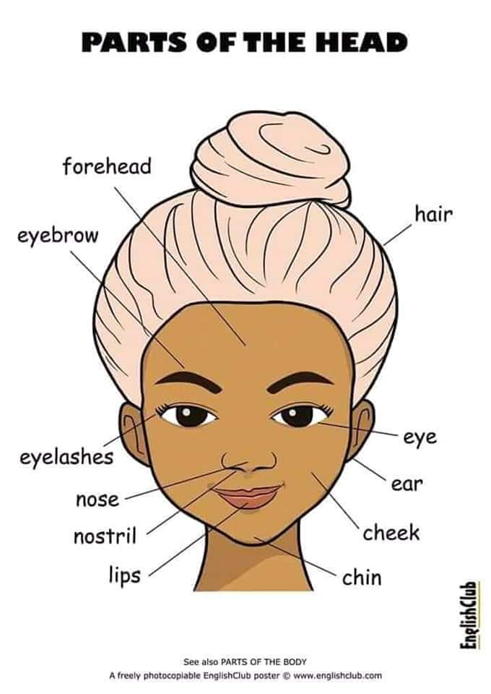

Slide 14
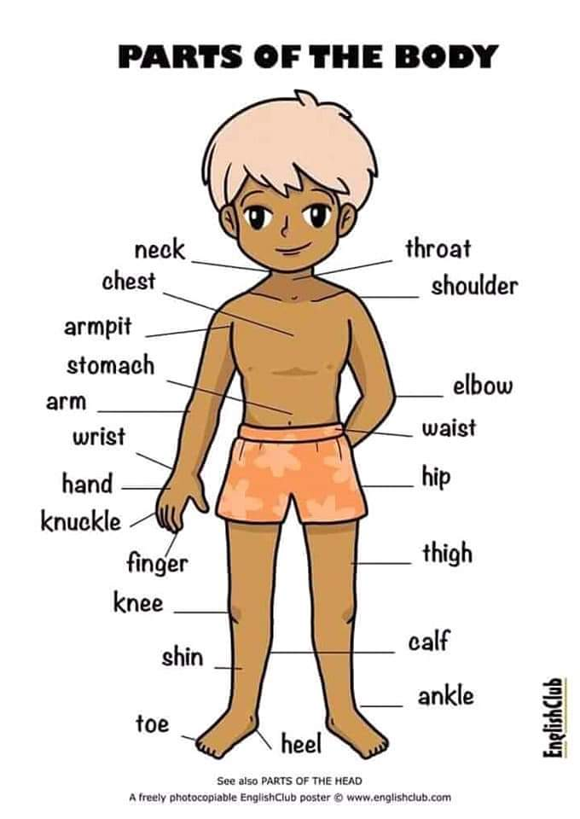

Slide 15
The different parts of the body are: head,torso,arms and legs
Head: forehead, eyebrow, hair, eyelashes, nose, nostril, mouth, tooth/teeth
Tongue, lips, chin, cheek, ear, eye
Torso: Waist , Hip , back, belly/stomach , breast, chest
Arms and legs: Shoulder, forearm, elbow, arm, wrist, hand, palm, fingers
legs waist hip thigh knee ankle foot calf heel sole toes…

Slide 16
Exercice 1: Find the essential part of the body which goes with the following verbs
Clap : - write:
See: - kiss:
Wash clothes: - breath:
Listen: - Wear rings:
Watch TV: - Wear bracelet:
Play football: - hug:
Sweep: - greet
Dance warba: - run
Smell: - swim
Eat:
Be pregnant:
Taste:

Slide 17
Common sports injuries
How does a nurse treat injuries to the body?

Slide 18
Answer:
A nurse treats injuries to the body by using first aid. For external injuries,such as swelling or bleeding, the nurse uses bandages. A nurse will also make an assessment of the condition of the patient by asking him/her questions.

Slide 19
Assessing new Patients
There are many common sports injuries . Ankles, knees and elbows can be sprained by unnatural movements.Shoulders and hips can be dislocated. Fingers can be jammed or broken.
Complete the dialogue: hurt, twist, leg, the problem, running, x-rays, ankle sprain
A: What seems to be 1………………,Lisa?
B: My 2………………….. really hurts.
A: I see.Where exactly does it 3……………………… ?
B: Mainly around my ankle.
A: Okay. Do you know what happened to make it 4……………………..?
B: I was 5 …………………………. and fell down. My foot twisted.
A: That ‘s likely the problem. Does it hurt anywhere else ?
B: No, just my leg.
A: Okay. I think it is just an 6……………….., but we’ ll take some 7 ………to make sure.

Slide 20
TREATMENT GUIDE
1- Approach the patient to assess the injury
2- Check for a pulse in unresponsive patients. Place your index and middle finger on the left wrist.
3- Look around the patient’s body for external injuries. These include swelling, bruises and bleeding.
4- Feel around your hands for bumps in the arms, legs,and extremities. Bumps suggest internal injury like a broken bone.
5-Elevate the legs above the heart in cases of swelling or fainting.
6-Do not move patients with potential spinal injuries. Keep the patient’s head in place.
7- Use first aid to treat any external injuries

Slide 21
Activity :Read the treatment guide and choose the correct answers.
1-What is the point of this guide ?
a)-when to use first aid
b)-Identifying a spinal injury
c)-treating patients with no pulse
d)-how to assess people’s injuries
2-What do you do first when a patient is unresponsive ?
a)-elevate the legs c)-Keep the head in place
b)-check for a pulse d)-search for broken bones
3- What can you infer about internal injuries?
a)-they cause patients to collapse
b)-They require patients to keep their head still
c)-They are usually accompanied by external injuries
d)-They are not clearly identified in an initial assessment

Slide 22
Activity : Choose the word that is suitable for each sentence
1- I twisted my ………. when i was running.
a)Shoulder b)ankle
2-The leg bends at the ………
a)Toe b)knee
3) Breaking even your smallest………… can make walking difficult.
a)toe b)hand
4)-This shoe barely fits on my……..
a) leg b) foot
5)-Give me your………and i will help you up.
a) Hand b) forearm

Slide 23
Activity2 :Match the words with the definitions
a)Spinal; b) wrist; c)arms; d) internal; e)hand; f) external; g)legs-
h) extremities
1-located on the outside of something.
2-the body parts located below the waist that people stand on.
3-The end of the arm that grabs and holds things.
4-relating to the bones in the back and neck.
5-parts of the body furthest to the center.
6-The body parts extending from the shoulders.
7-located inside of something.
8-The body part that connects the hand to the arm.

Slide 24
Patient assessment
Name: Emelie KOAMA Sex: female Age: 14
Primary physician: Dr Kabore
Parent: Alex Koama Home phone: 72156894
How did injuries occur : A bicycle accident
Injuries description :
The patient has no severe head trauma. There are minor scrapes on the
face and a small bruise on her jaw. The patient has no deep cut on the
forehead. There are two minor cuts between the right eye and eyebrow.
The nose appears bruised and the upper lip is bloody and swollen. There
are scrapes on her left cheek near the left ear.

Slide 25
Activity1: Read the patient assessment. Then choose the correct answers
1) What is the purpose of the document?
a- to list the patient’s medical history
b- to report where facial injuries are located
c- to explain how to treat the patient’s injuries
d- to describe how the patient’s injuries have healed
2) The patient has injuries in all of the following areas except
a- her cheek c- her head
b- her jaw d- her lips
3) Which body parts are bruised?
a- eyebrow and jaw b- nose and jaw
C- cheek and nose d- cheek and ear

Slide 26
Exercise 2: Match the words (1-7) with the definitions( A-G)
1- lips; 2-face; 3-forehead; 4-cheek; 5-head; 6-ears; 7-eyes
The organs that detect sound
The part of the face above the eyebrows.
The body part that contains the brain and skull
The sensitive organ surrounding the mouth
The front part of the head that contains the sensory organs
The fleshy part of the face on other side of the nose
The organs that detect sight

Slide 27
Group work : Find the main parts of the body or the organs affected or concerned by the following diseases.
Hepatitis
Hypertension
Diarohae
Myopia
Renal failure
Nasal bleeding
Sinusitis
Pulmonary embolism
Dermatitis
Pneumonia
Caries
Corona Virus Disease

Slide 28
Should abortion be legalised in your country?

